Slide 1

Project PathFinder 22 January 2021
Capstone ii – Aidi 2005- group 2
Team Ishla

Slide 2
Who we are
Team name: Ishla (Optimum Path)
Product name: Pathfinder
Tech-Lead: Meryl Gabrielle Tubio (100763231)
Members:
Izza Godinez (100556078)
Nandini Malhotra (100768797)
Maviya Javed Shaikh (100766785)

Slide 3
Executive Summary
Optimal path algorithms are a major interest in artificial intelligence. It has many applications in business, including product delivery and shipment processes, as well as in navigation. The aim for this project is to allow the user to create an optimal path between different stores to allow them to complete their shopping lists with various items in the shortest possible time.

Slide 4
Problem Statement
“To find the optimal path from the starting point (source), covering all the sub-destinations”.
The problem statements aim at determining the closest sub-destination from the current position, the starting point being the user’s current location.

Slide 5
AI Agent
AI agent is the artificial intelligent component that helps to achieve the goal of our project. Based on the business problem to find the shortest path for the user, we will be using Utility-based AI agents. The reason for choosing Utility-based AI agent is that it not only helps to find the shortest path, but it also provides the best possible way to achieve it.

Slide 6
Project Details
Data / Software Requirements
A database of common shopping list items and what category of items they fall under
Information on what stores have each item available
Data: | Software:
A database of common shopping list items and what category of items they fall under Information on what stores have each item available | For front end: HTML, CSS For back end: Python, SQL For deployment: GitHub

Slide 7
Project Details (contd.)
6. Assumptions
The data mentioned in the project is created based on the different use case scenarios without any bias and discrimination.
7 Constraints
For the purpose of the project, it will be assumed that grocery items will be found in grocery stores and electronics items found in electronics stores, regardless of the stores’ actual stock
Items that can be included in the shopping list will be limited to those that are already in the database

Slide 8
Product Details

Slide 9
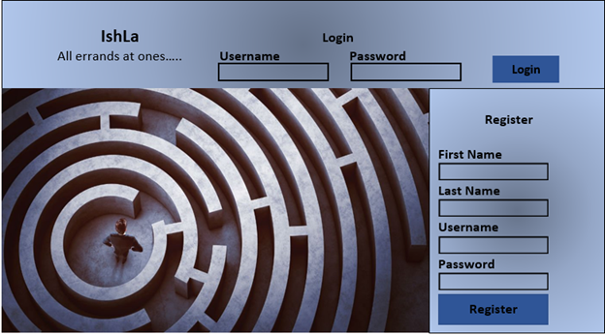
1. Ishla Layout
The User Registration/ Login Page
On this page the user would either login or register as new user.

Slide 10
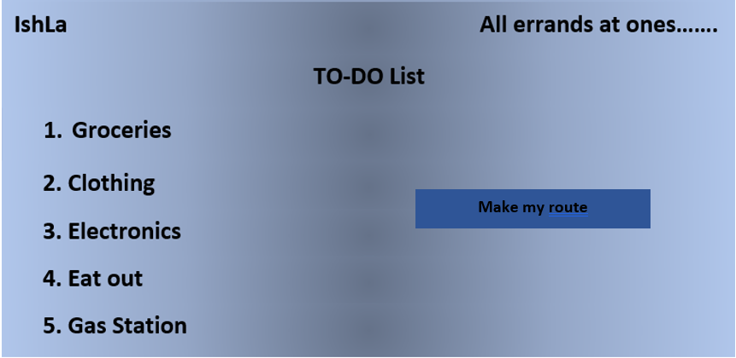
2. The home page
This page would display the list of errands that a person needs to do. After selecting each category, items in the list would open a new page to select the type of item the user wants to buy.

Slide 11
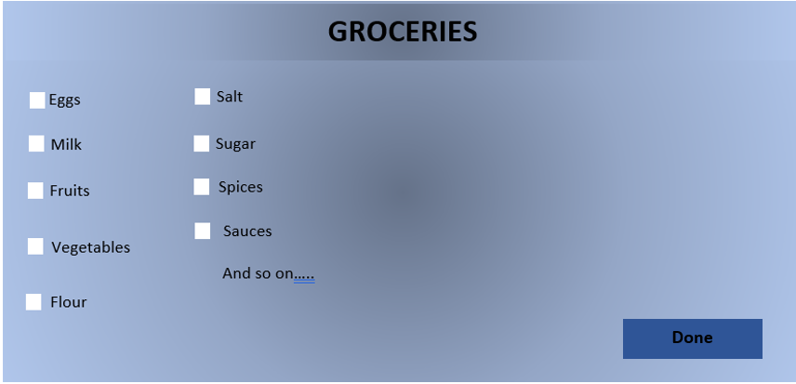
3. The Groceries page
The user would select the items it needs to buy by checking the check box.

Slide 12
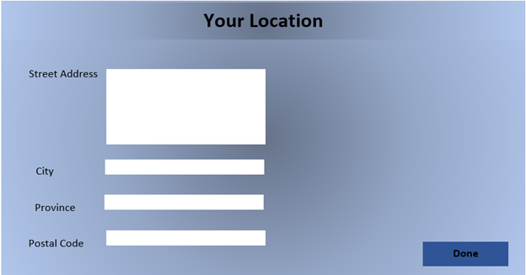
4. Location Verification
After selecting the items, the user would click on the “Make my route button” on the home page. This would direct him to a screen where the user address would be asked.

Slide 13
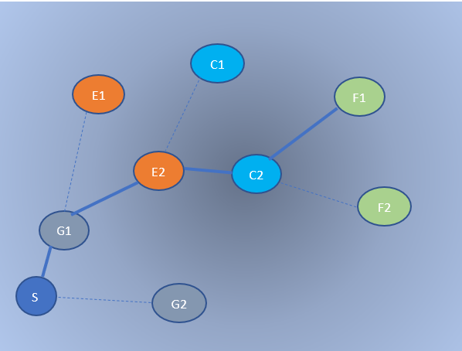
5. Visualization Map
After clicking on Done, the user would be directed to a map.

Slide 14
5. Visualization Map (contd.)
The user starts from S and first the closest place to S is determined which is Grocery store 1 (G1). Which means that the user should first visit the grocery store for the groceries. After the grocery store the user can go out to buy electronics at E2 which is close in comparison to E1 from G1. After buying electronics from E2, the closest store is Clothing store C2 and at the end the user can eat out at F1. Hence the optimal path followed by the user would be S->G1->E2->C2->F1.

Slide 15
Software Requirements
After selecting the items, the user would click on the “Make my route button” on the home page. This would direct him to a screen where the user address would be asked.

Slide 16
Next Steps
Presentation of Minimum Viable Product (version I)

